Slide 1

Server and Systems Administration Module Code : CSC3504
Simeon NDAYAMBAJE
Server and Systems Administration , CSC3504
1

Slide 2
Chapter 4
Booting & File Management

Slide 3
Booting
Booting is the process of starting a computer and making it ready for use by loading an operating system onto the main memory
In the Booting, System will check all the hardware and Software
In order for a computer to successfully boot, its BIOS, Operating System and hardware components must all be working properly; failure of any one of these three elements will likely result in a failed boot sequence

Slide 4
System Boot Process
When the power gets ON, memory testing (RAM test) is performed.
When this is OK, a boot loader program checks all H/W attached with computer system. Such as keyboard, hard disk, CPU, etc.
After listing H/Ws, the boot loader program searches for operating system in secondary storage device. If it found, it calls the main program of operating system and loads operating system into RAM.
After successfully loading the operating system, it operating system prompt. If it is Windows then a desktop is displayed with Start Button.

Slide 5
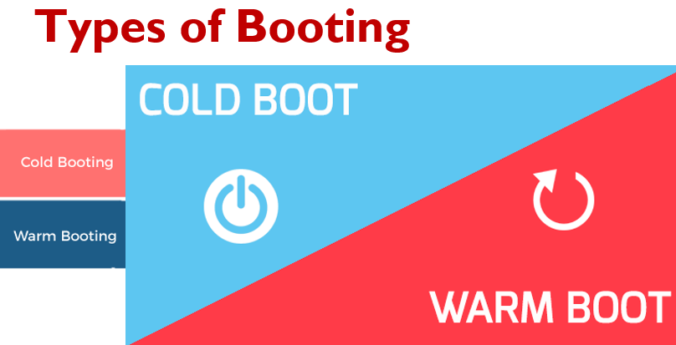

Slide 6
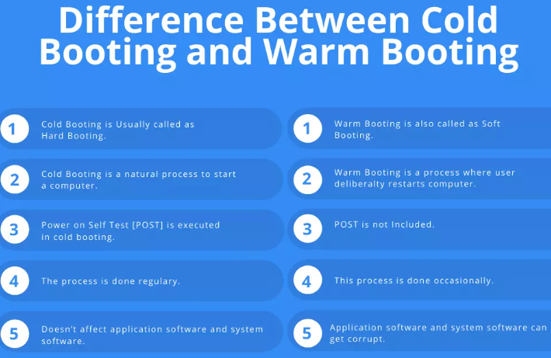

Slide 7

Types of Booting
Cold boot(Hard Booting):
Is described as a process of starting a computer after switching it off. A good example is turning on a desktop computer after power cable is plugged in.

Slide 8

Types of Booting
Warm Boot( Soft Booting):
it is a method where the ‘operating system’ (OS) is restarted without switching it off.
It happen in case (computer locks, freezes or crashes, new program is installed, After installing external Hardware
This type of booting is faster and helps the (OS) recover from errors easily.
When CTRL, ALT and DEL keys are press simultaneously, and then warm booting is performed.

Slide 9
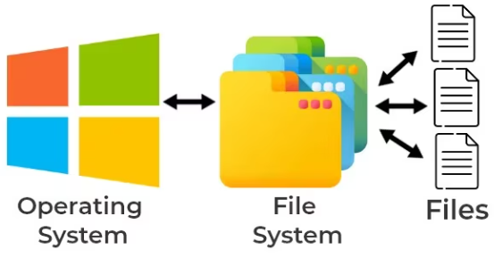
File system
File system is a structured representation of data and a process of how to manages data on a storage disk

Slide 10
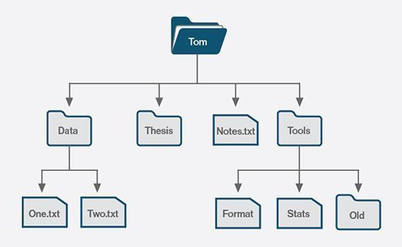
Example of file system in Windows

Slide 11
File Manipulations(Operations)
Delete,
Read
Move,
Copy
Past,
Open
save

Slide 12
File Attributes
Extension
Name
Date of modification
Size
Location

Slide 13
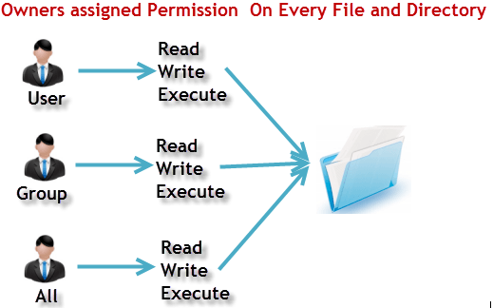
File system permissions

Slide 14
File system permissions
Notation
Symbolic notation: Represents permissions using symbols (r, w, x, and -)
Octal (Absolute) notation: represents permissions using a three-digit number read (4), write (2), and execute (1).

Slide 15
Symbolic Notation and Description
"r" means: read permission "w" means: write permission "x" means: execute permission
“-” means: no permission

Slide 16
Symbolic Notation
Symbolic notation represents permissions using symbols (r, w, x, and -) to indicate read, write, and execute permissions, respectively.
It also includes additional symbols (u, g, o, and a) to specify whether permissions apply to the owner, group, others, or all users.
For example, u+x means to add execute permission for the owner.

Slide 17
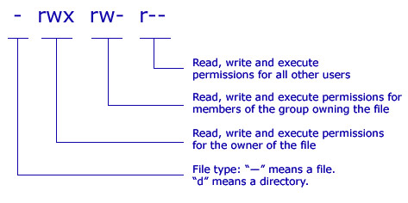
File system permissions

Slide 18
Absolute notation
When Linux file permissions are represented by numbers.
In numeric mode, a three-digit value represents specific file permissions (for example, 744.)
The first digit is for owner permissions, the second digit is for group permissions, and the third is for other users. Each permission has a numeric value assigned to it:
r(ead) has the value of 4.
w(rite) has the value of 2.
(e)x(ecute) has the value of 1.
no permission has the value of 0.

Slide 19
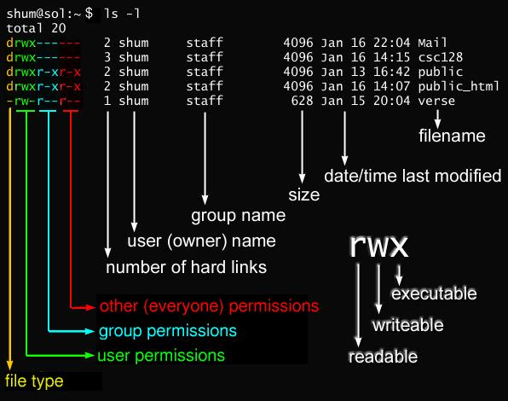
File system permissions

Slide 20
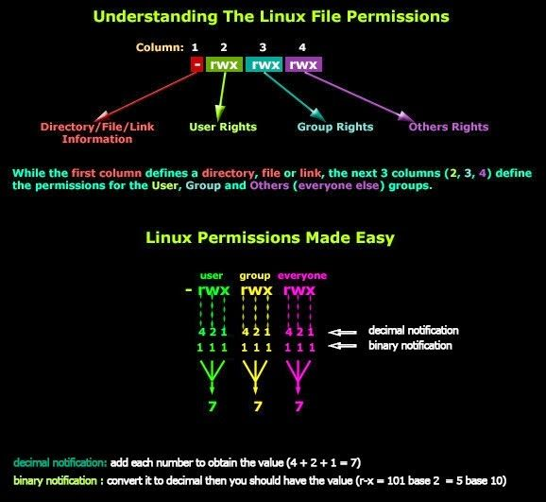
File system permissions

Slide 21
File permission table
Number | Permission Type | Symbol
0 | No Permission | ---
1 | Execute | --x
2 | Write | -w-
3 | Execute + Write | -wx
4 | Read | r--
5 | Read + Execute | r-x
6 | Read +Write | rw-
7 | Read + Write +Execute | rwx

Slide 22
Thank you

